Slide 1
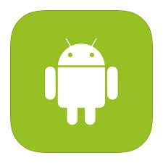
Android
Introduction and Basic
Day 1

Slide 2
Topics
Android Overview
Android Environment Setup
How Android Works
Android Components - Overview
Hello World!

Slide 3
Android Overview
Android is an open source and Linux-based Operating System for mobile devices such as smartphones and tablet computers.
Android was developed by the Open Handset Alliance, led by Google, and other companies.
The first beta version of the Android Software Development Kit (SDK) was released by Google in 2007 where as the first commercial version, Android 1.0, was released in September 2008.
The source code for Android is available under free and open source software licenses.
Google publishes most of the code under the Apache License version 2.0 and the rest, Linux kernel changes, under the GNU General Public License version 2.

Slide 4
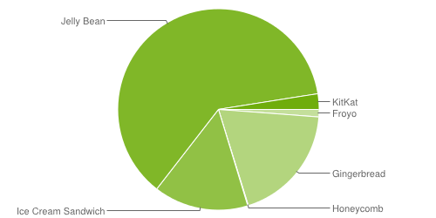
Why Android
Building on the contributions of the open-source Linux community and more than 300 hardware, software, and carrier partners, Android has rapidly become the fastest-growing mobile OS.
Every day more than 1 million new Android devices are activated worldwide.
62%
2.5%
1.2%
19%
15.2%
0.1%

Slide 5
Environment Setup
http://developer.android.com/sdk/index.html
The bundle contains:-
Eclipse + ADT plugin
Android SDK Tools
Android Platform-tools
The latest Android platform
The latest Android system image for the emulator

Slide 6
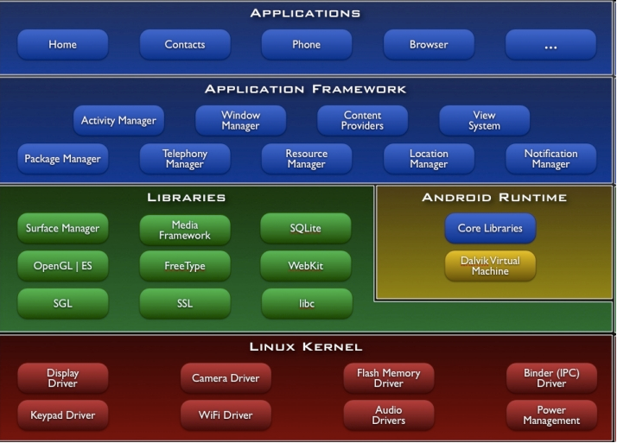
Android Architecture

Slide 7

Android Architecture
On the very top, we have Android Applications.
There are applications provided by Android by default and those have to be there.
Application that you will develop will be in this category.

Slide 8
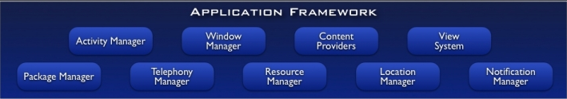
Android Architecture
Below Applications, we have Application framework.
The codes are mostly in java.
Your application leverages the APIs.
You are allowed to replace the components as per your need.

Slide 9
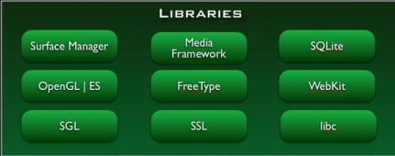
Android Architecture
Below Application framework, We have Libraries.
The codes are in C/C++.
This libraries are used by Android system.

Slide 10
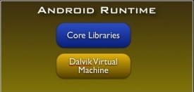
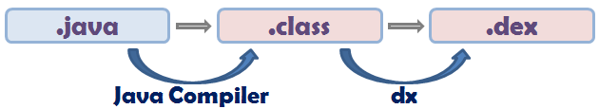
Android Architecture
Core Libraries provide functionality available in core libraries of Java language like utilities, network access, graphics etc.
DVM provides the environment in which Android application runs.
Each Android application runs in it’s own process and has it’s own instance of DVM.

Slide 11
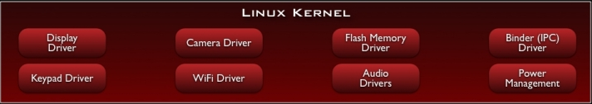
Android Architecture
All drivers are here.
It’s modified as per mobile computing needs.
Binder (IPC) Driver, Power Management are introduced by Android and some other like Memory Management were modified.
This layer provides an abstraction layer between the H/W and the rest of the S/W stack.

Slide 12
Android Components
Activity
Service
Broadcast Receivers
Content Providers

Slide 13
Android Components
Activities:-
Application component that provides a screen with which user interacts.
An application usually consists of multiple Activities.
One Activity in an application is specified as ‘main’ Activity. This Activity is presented to the user when the applications runs for the first time.
Each time a new activity starts, the previous activity is stopped, but the system preserves the activity in a stack (the "back stack").
The back stack abides to the basic "last in, first out" stack mechanism, so, when the user is done with the current activity and presses the Back button, it is popped from the stack (and destroyed) and the previous activity resumes.

Slide 14
Android Components
Services:-
An application component that can perform long-running operations in the background and does not provide a user interface.
Another application component can start a service and it will continue to run in the background even if the user switches to another application.
Additionally, a component can bind to a service to interact with it and even perform interprocess communication (IPC).

Slide 15
Android Components
Broadcast Receivers:-
A component that responds to system-wide broadcast announcements.
Many broadcasts originate from the system - for example, a broadcast announcing that the screen has turned off, the battery is low, or a picture was captured.
Apps can also initiate broadcasts - for example, to let other apps know that some data has been downloaded to the device and is available for them to use.
More commonly, though, a broadcast receiver is just a "gateway" to other components and is intended to do a very minimal amount of work.

Slide 16
Android Components
Content Providers:-
A content provider manages a shared set of app data.
You can store the data in the file system, an SQLite database, on the web, or any other persistent storage location your app can access.
Through the content provider, other apps can query or even modify the data (if the content provider allows it).

Slide 17
Hello World!
Finally.
This is what you guys were waiting for and for this there was so much build up.
Enough talks.
Let’s say Hello to the World of Android.

Slide 18
End of Day 1

